Slide 1


Fundamentals of Music Processing
Chapter 6: Tempo and Beat Tracking
Meinard Müller
International Audio Laboratories Erlangen
www.music-processing.de

Slide 2
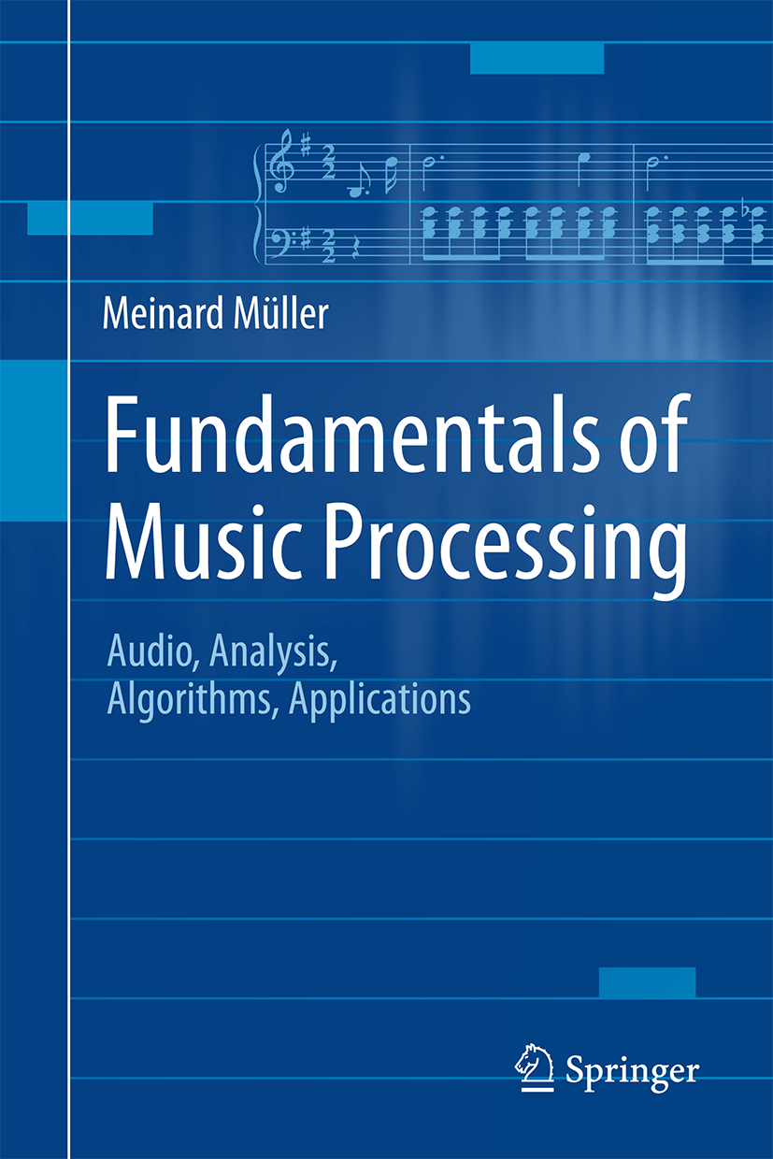

Book: Fundamentals of Music Processing
Meinard Müller
Fundamentals of Music Processing
Audio, Analysis, Algorithms, Applications
483 p., 249 illus., 30 illus. in color, hardcover
ISBN: 978-3-319-21944-8
Springer, 2015
Accompanying website:
www.music-processing.de

Slide 3
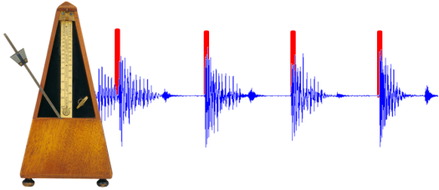
Chapter 6: Tempo and Beat Tracking
6.1 Onset Detection
6.2 Tempo Analysis
6.3 Beat and Pulse Tracking
6.4 Further Notes
Tempo and beat are further fundamental properties of music. In Chapter 6, we introduce the basic ideas on how to extract tempo-related information from audio recordings. In this scenario, a first challenge is to locate note onset information—a task that requires methods for detecting changes in energy and spectral content. To derive tempo and beat information, note onset candidates are then analyzed with regard to quasiperiodic patterns. This leads us to the study of general methods for local periodicity analysis of time series.

Slide 4
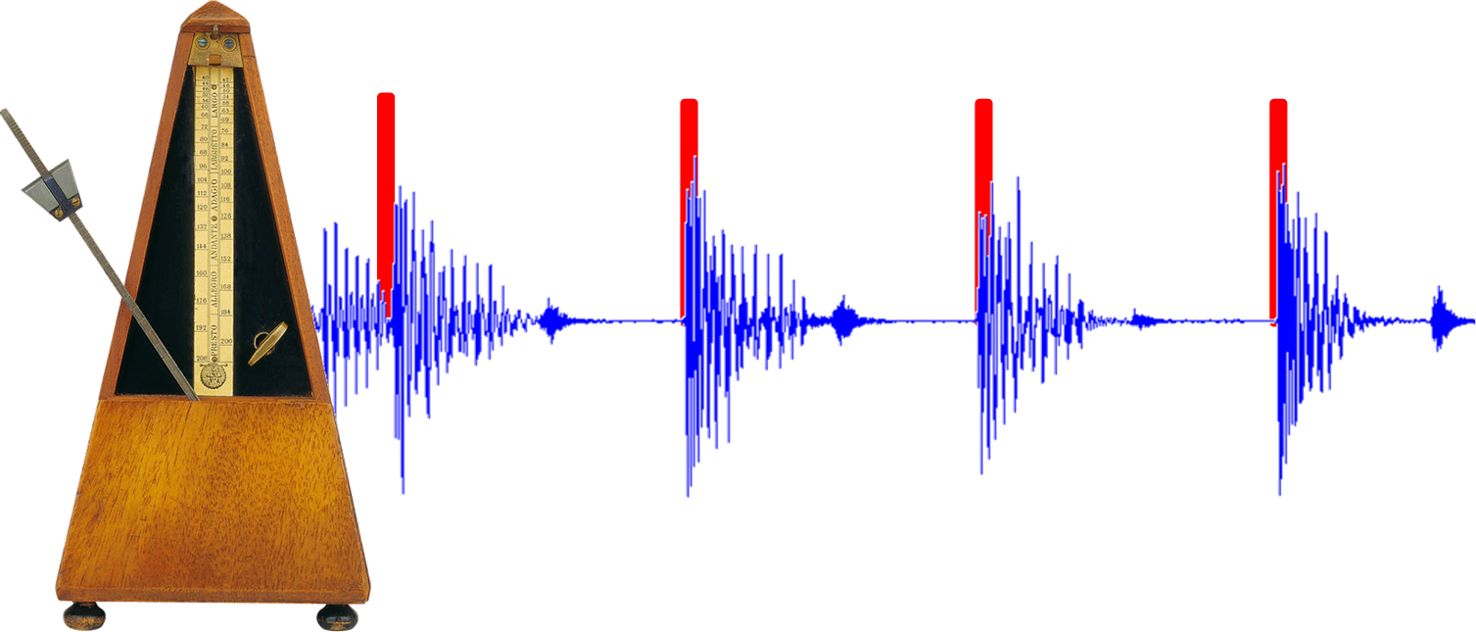
6 Tempo and Beat Tracking
Teaser

Slide 5
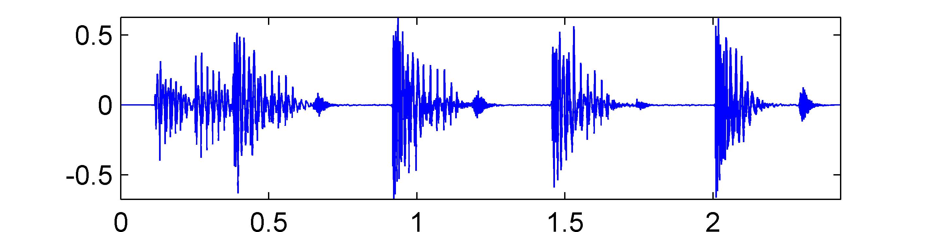
6 Tempo and Beat Tracking
Fig. 6.1
Time (seconds)

Slide 6
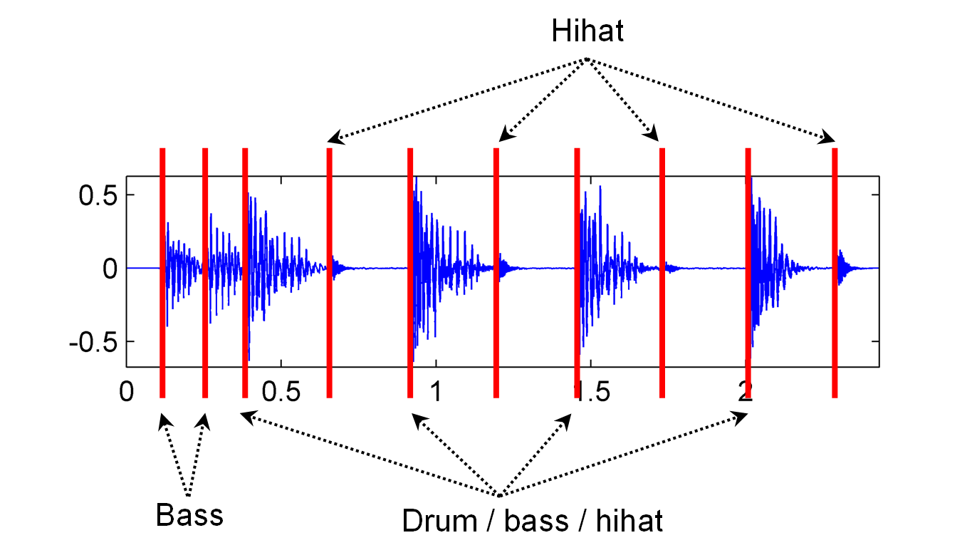
6 Tempo and Beat Tracking
Fig. 6.1

Slide 7
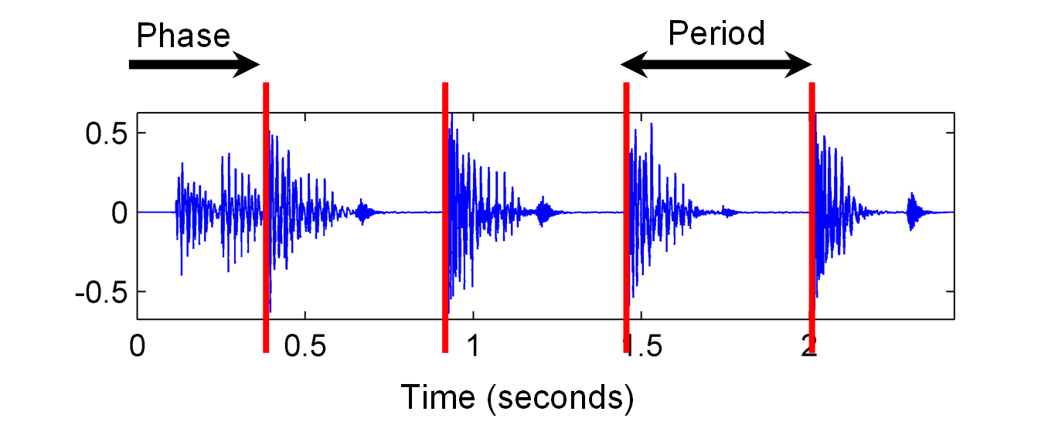
6 Tempo and Beat Tracking
Fig. 6.1

Slide 8
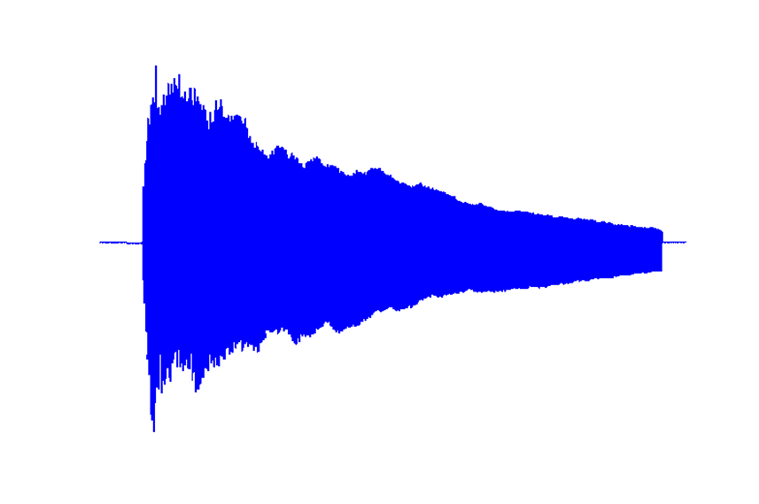
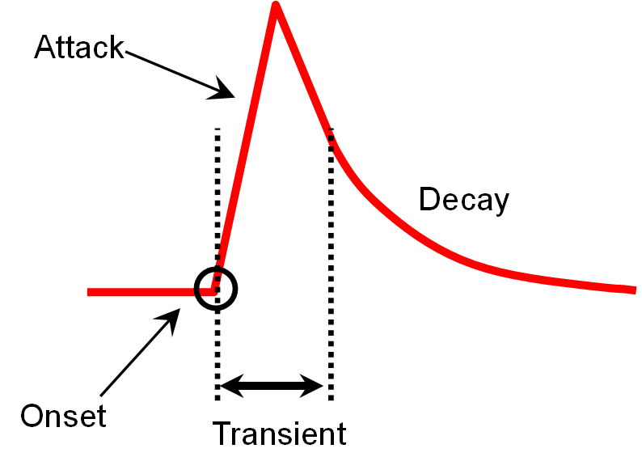
6.1 Onset Detection
Fig. 6.2

Slide 9
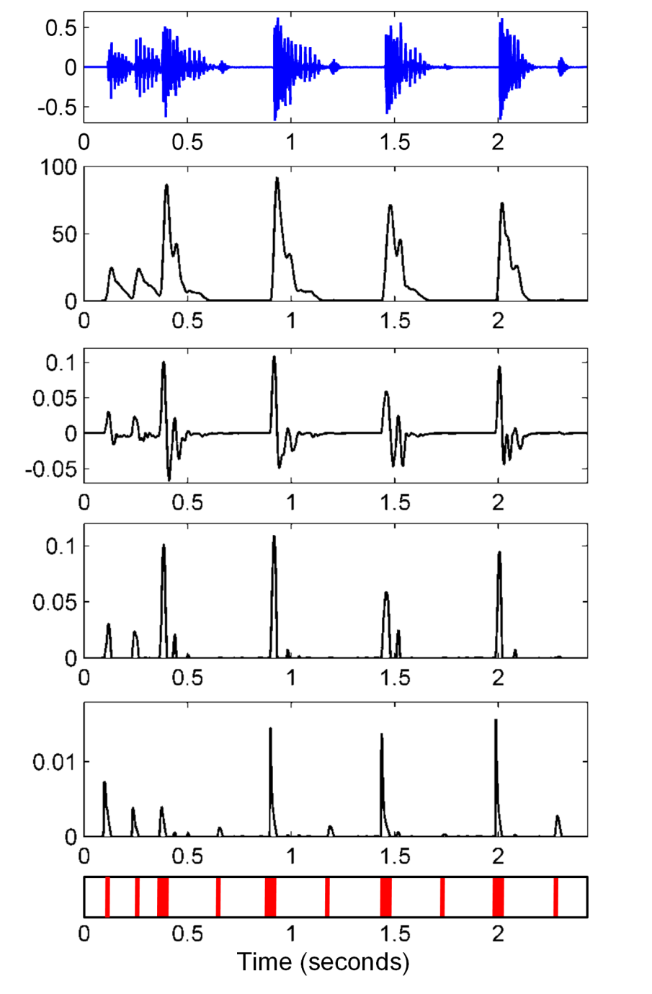
6.1 Onset Detection
Fig. 6.3

Slide 10

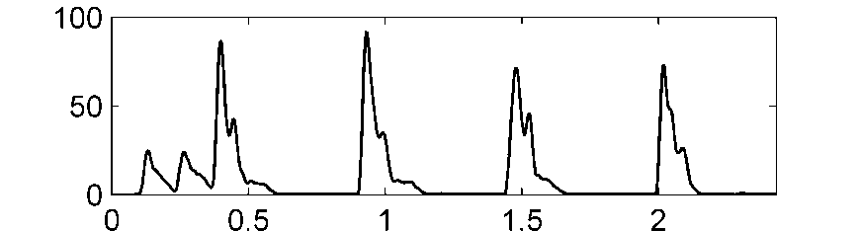
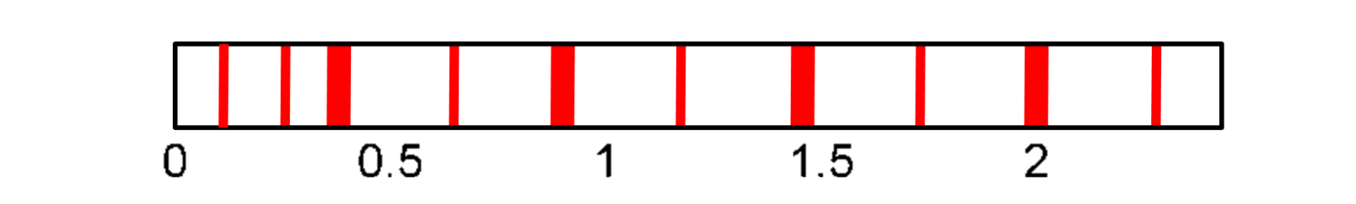
6.1 Onset Detection
Fig. 6.3
Time (seconds)

Slide 11
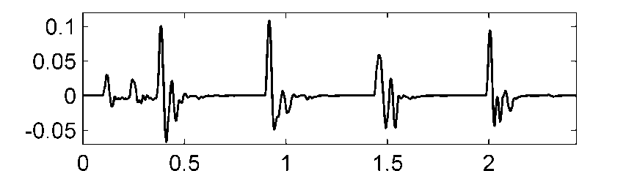
6.1 Onset Detection
Fig. 6.3
Time (seconds)

Slide 12
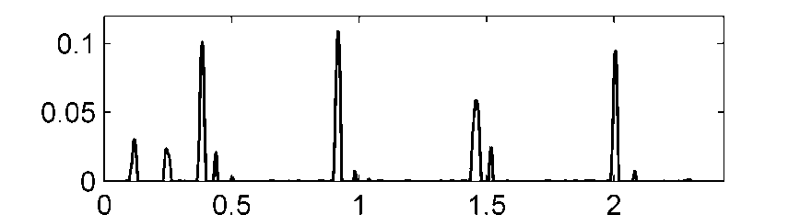
6.1 Onset Detection
Fig. 6.3
Time (seconds)

Slide 13
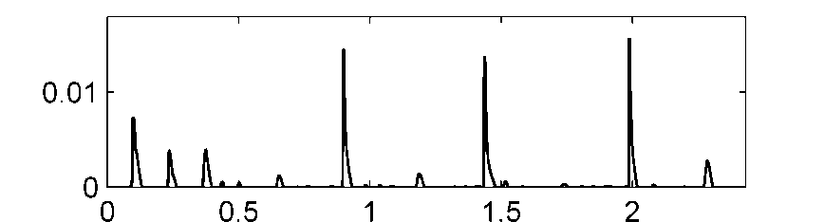
6.1 Onset Detection
Fig. 6.3
Time (seconds)

Slide 14
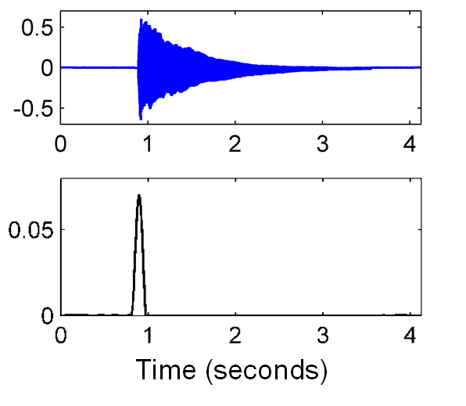
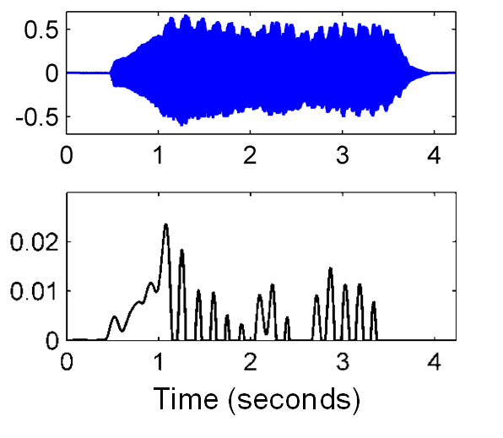
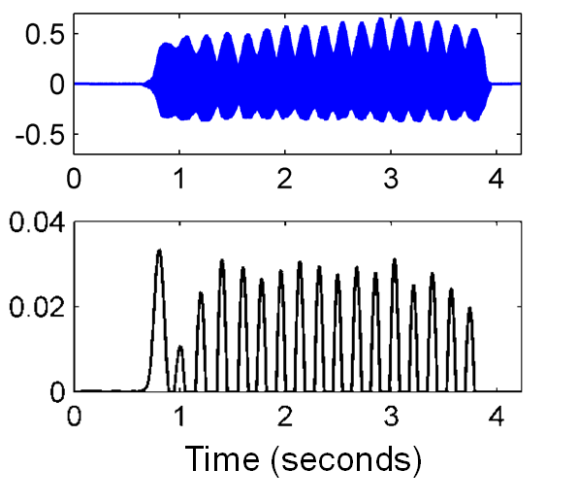
6.1 Onset Detection
Fig. 6.4

Slide 15
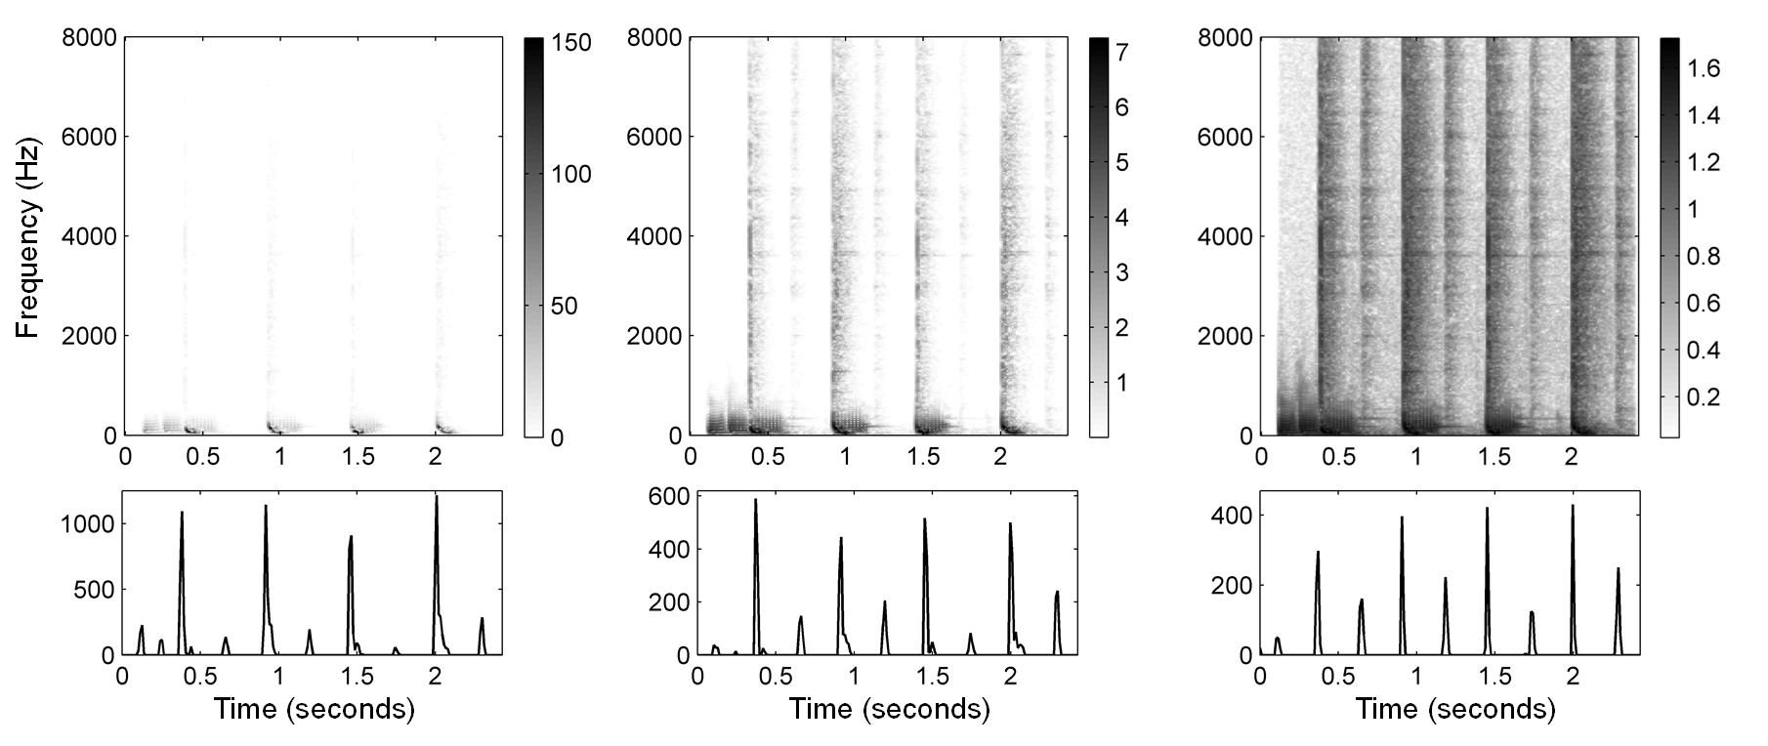
6.1 Onset Detection
Fig. 6.5

Slide 16
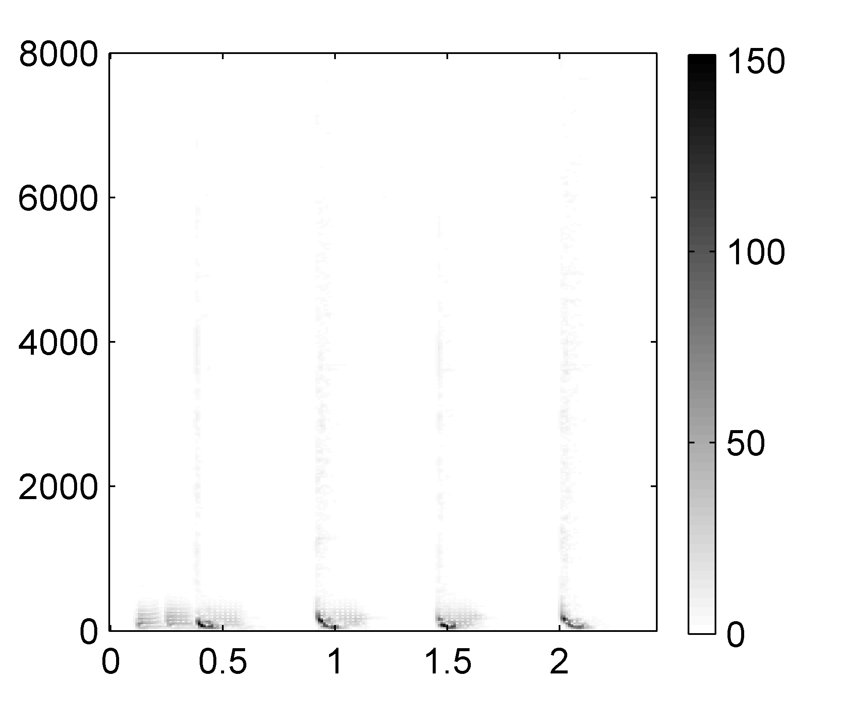
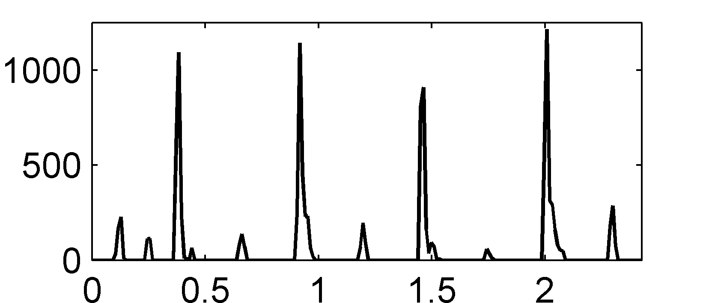
6.1 Onset Detection
Fig. 6.5
Frequency (Hz)
Time (seconds)

Slide 17
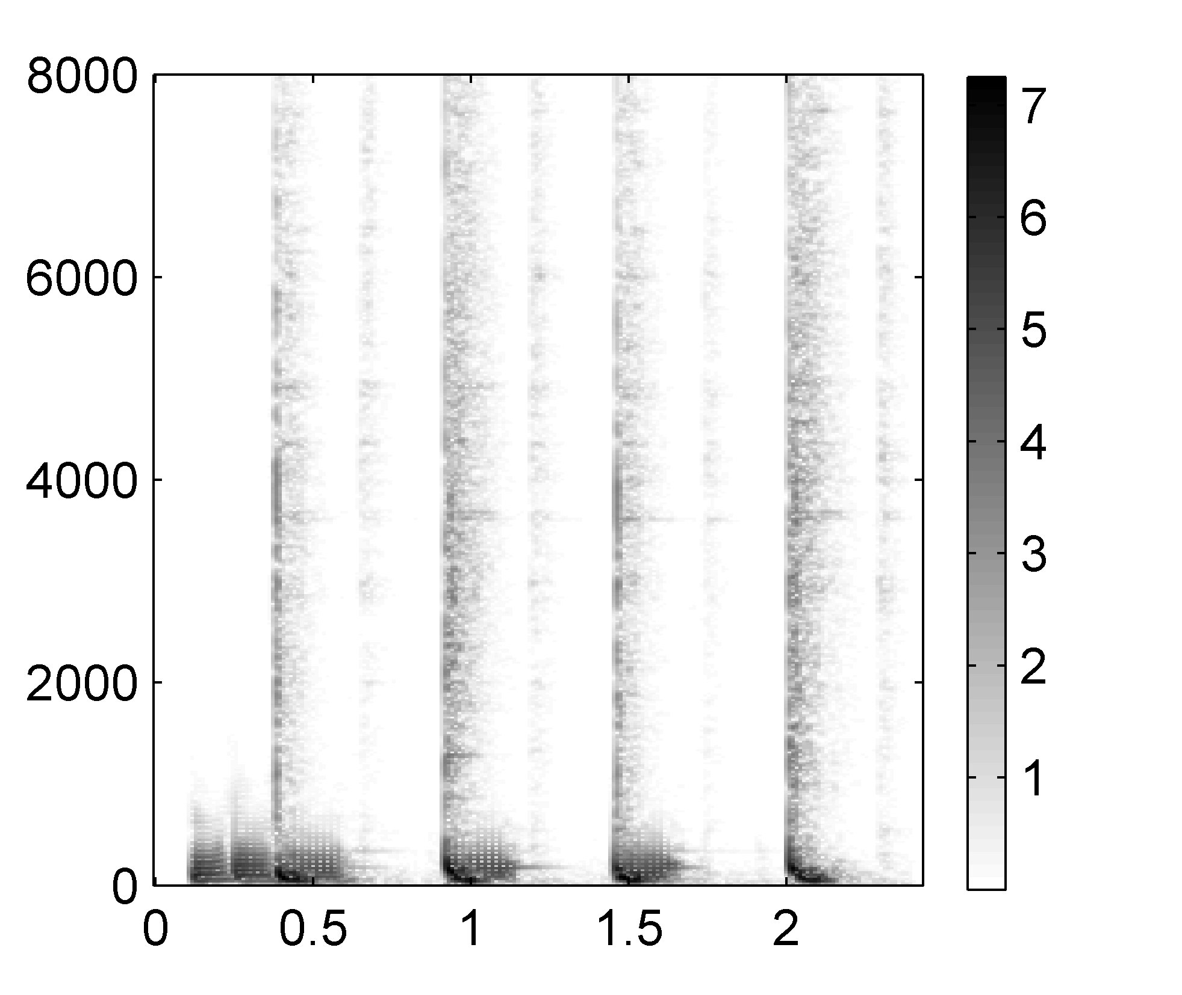
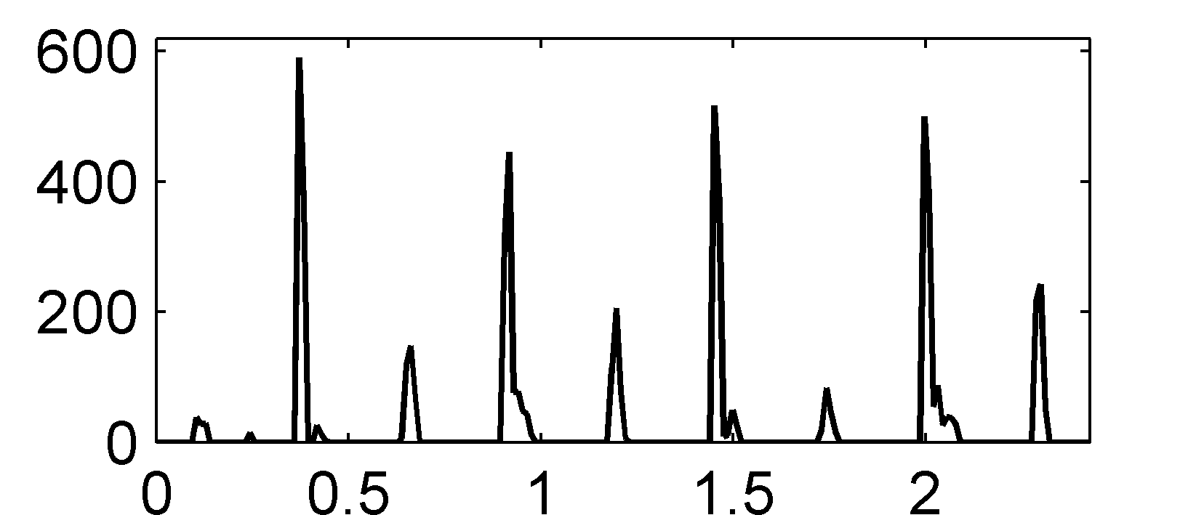
6.1 Onset Detection
Fig. 6.5
Frequency (Hz)
Time (seconds)

Slide 18
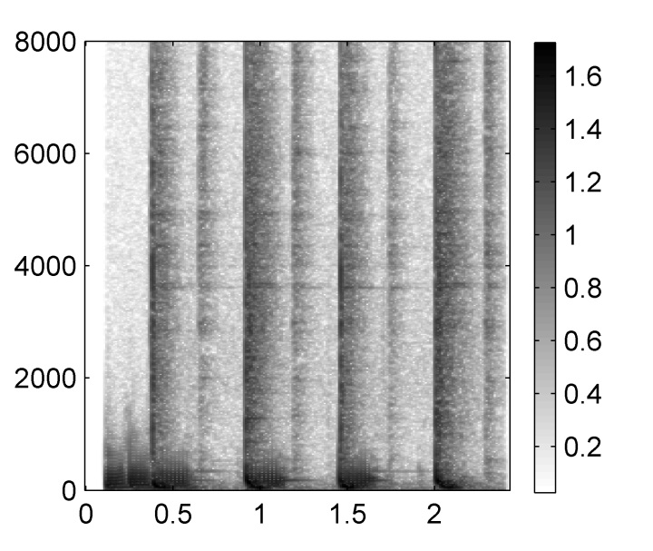
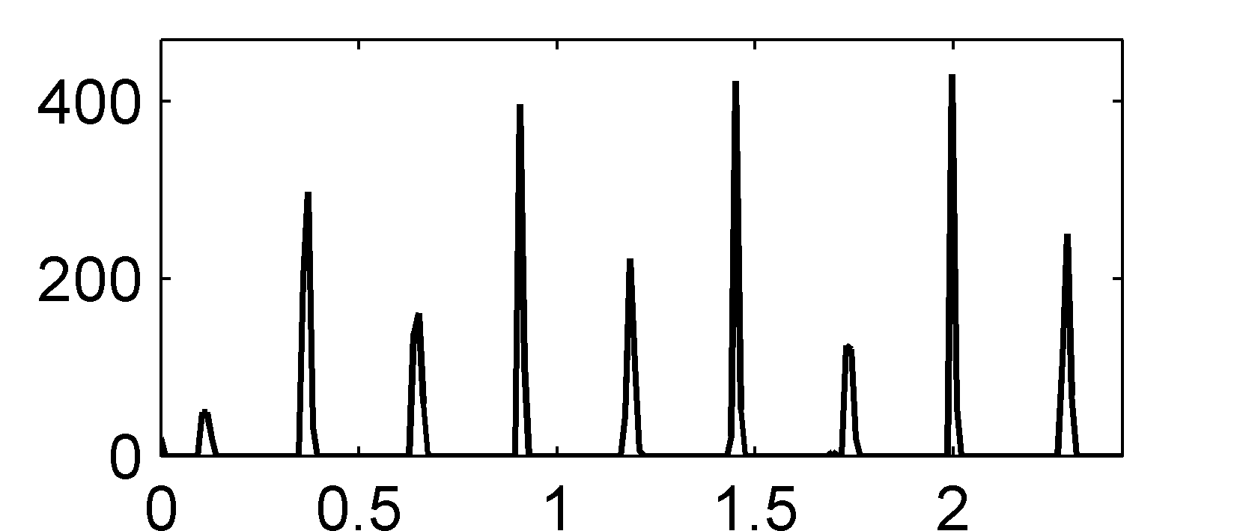
6.1 Onset Detection
Fig. 6.5
Frequency (Hz)
Time (seconds)

Slide 19
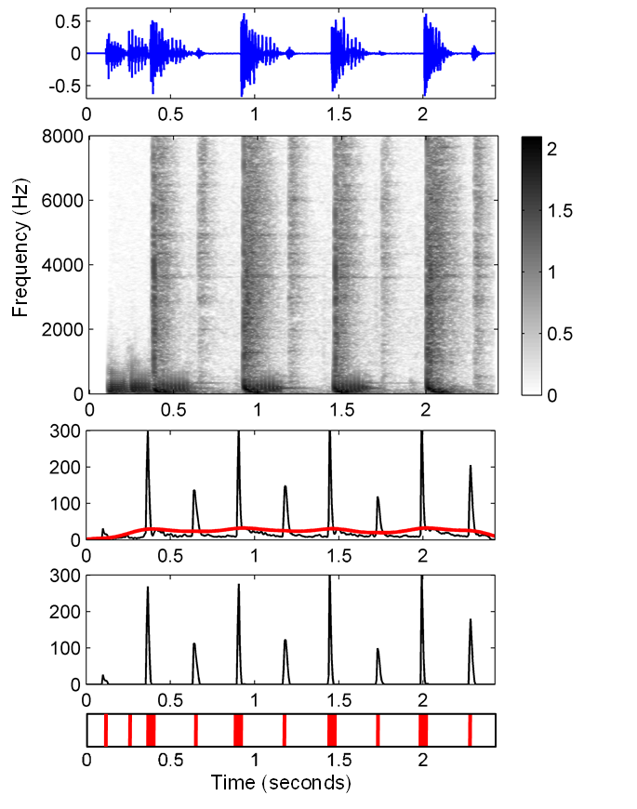
6.1 Onset Detection
Fig. 6.6

Slide 20
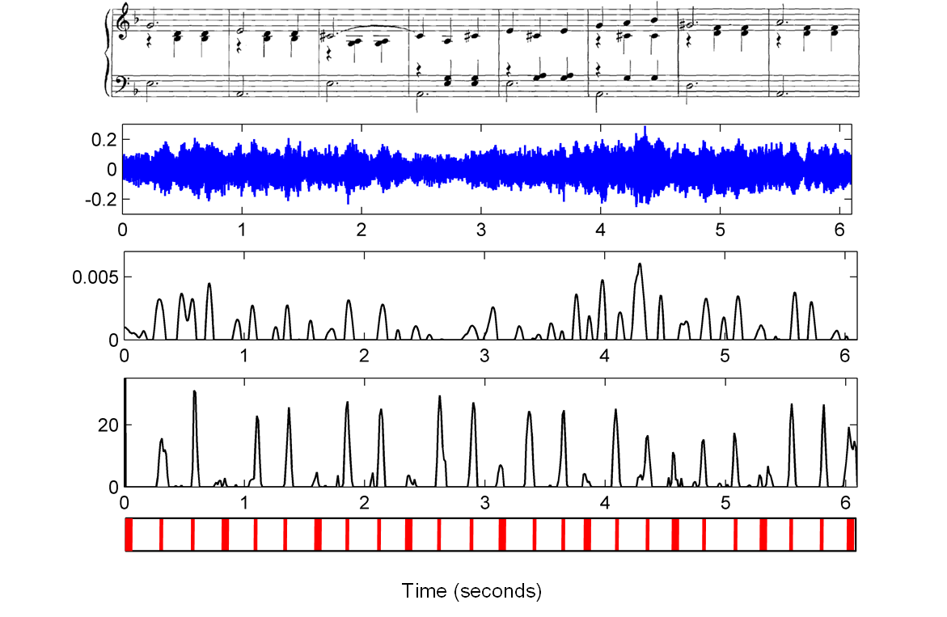
6.1 Onset Detection
Fig. 6.7

Slide 21
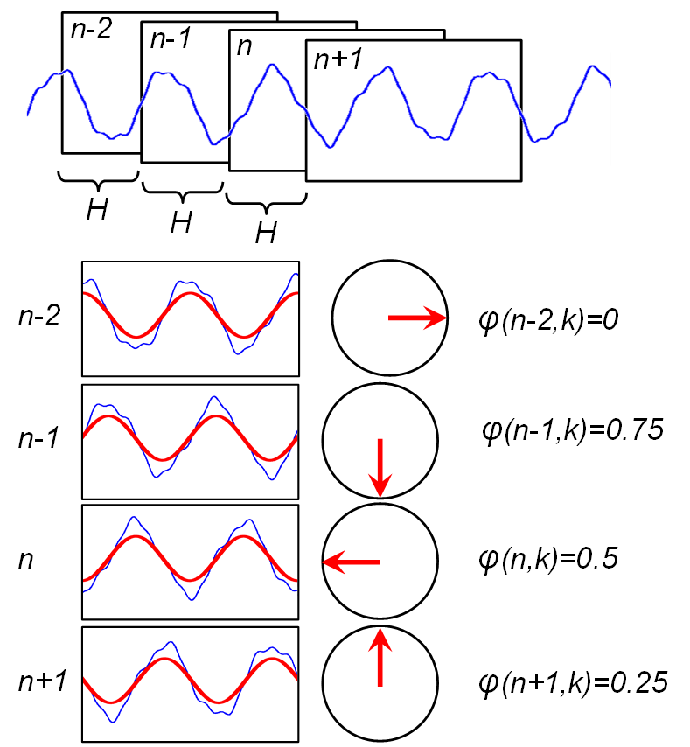
6.1 Onset Detection
Fig. 6.8

Slide 22
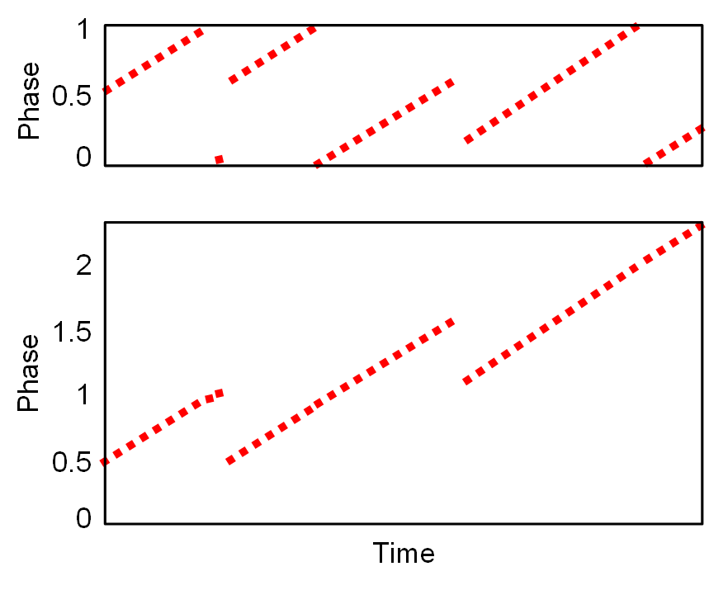
6.1 Onset Detection
Fig. 6.9

Slide 23
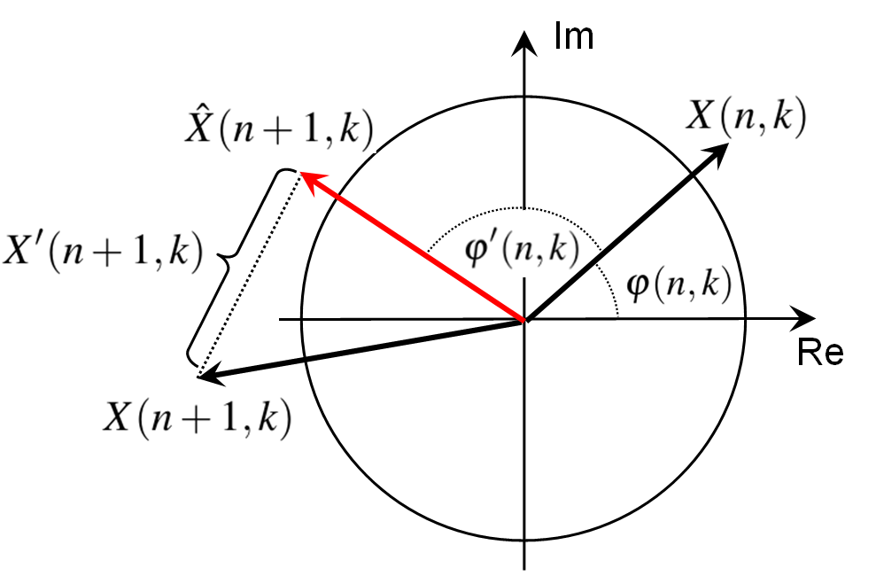
6.1 Onset Detection
Fig. 6.10

Slide 24
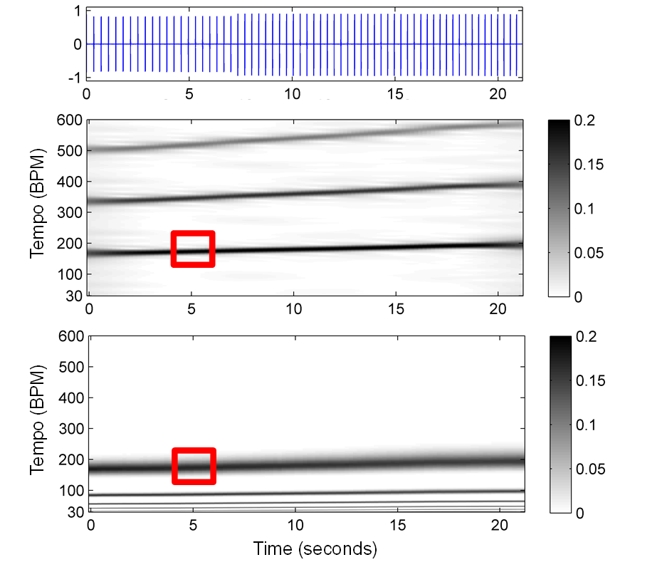
6.1 Onset Detection
Fig. 6.11

Slide 25
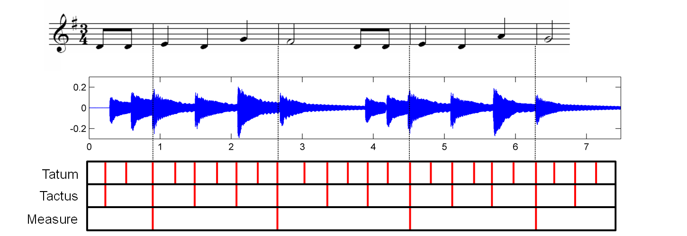
6.2 Tempo Analysis
Fig. 6.12

Slide 26
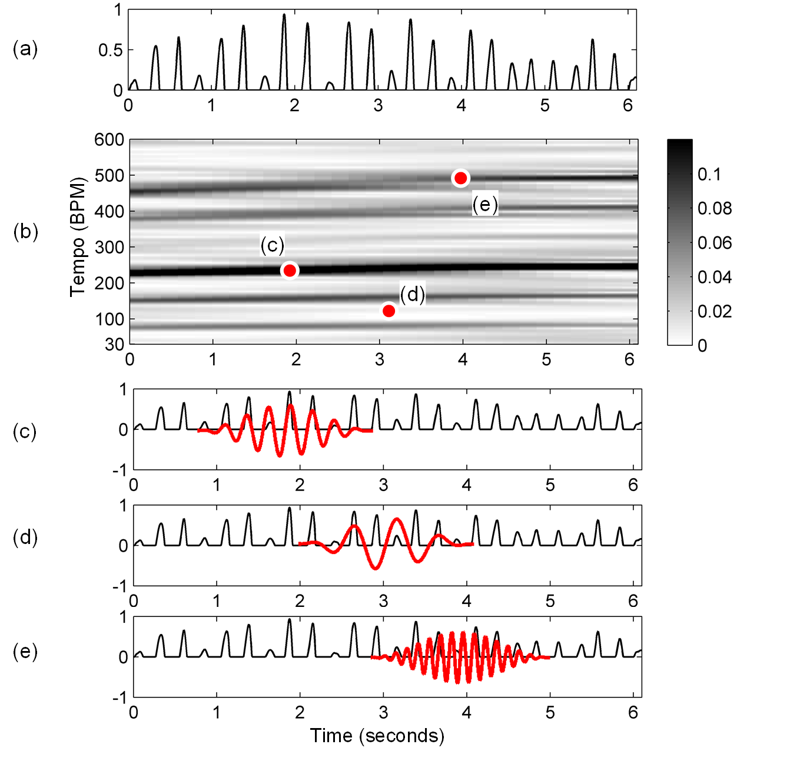
6.2 Tempo Analysis
Fig. 6.13

Slide 27
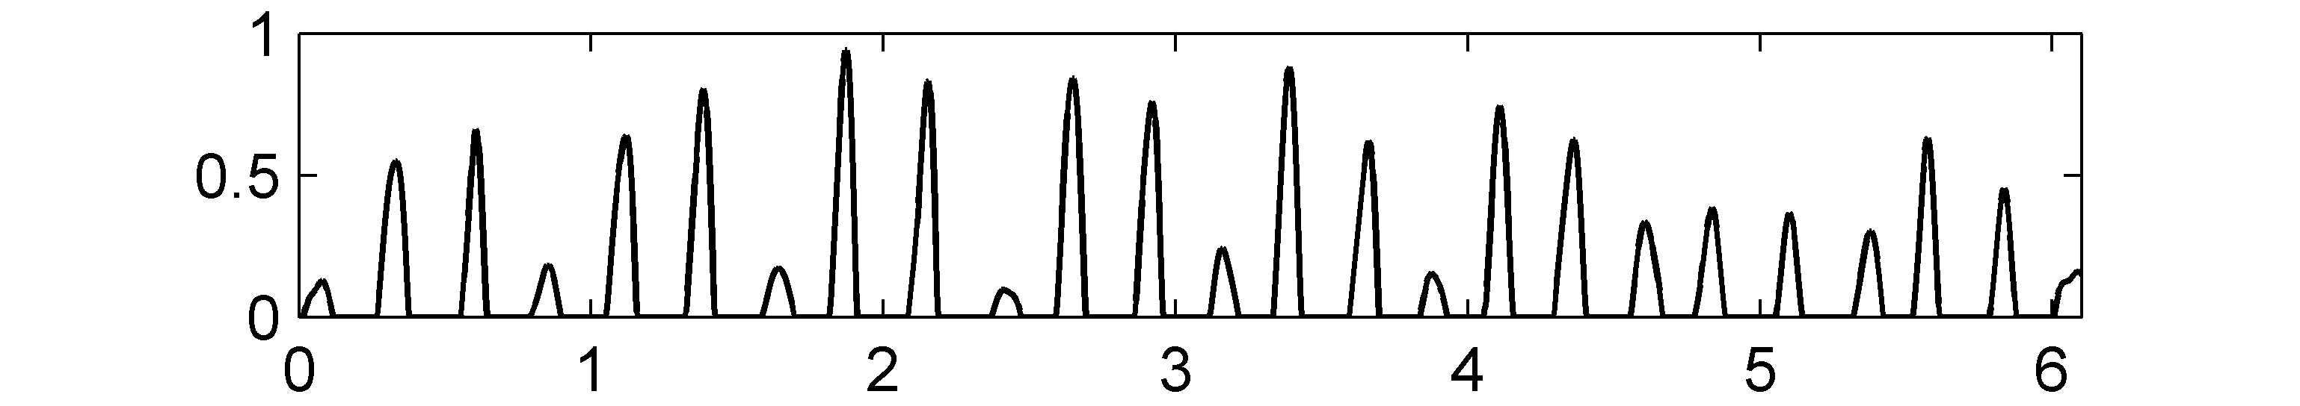
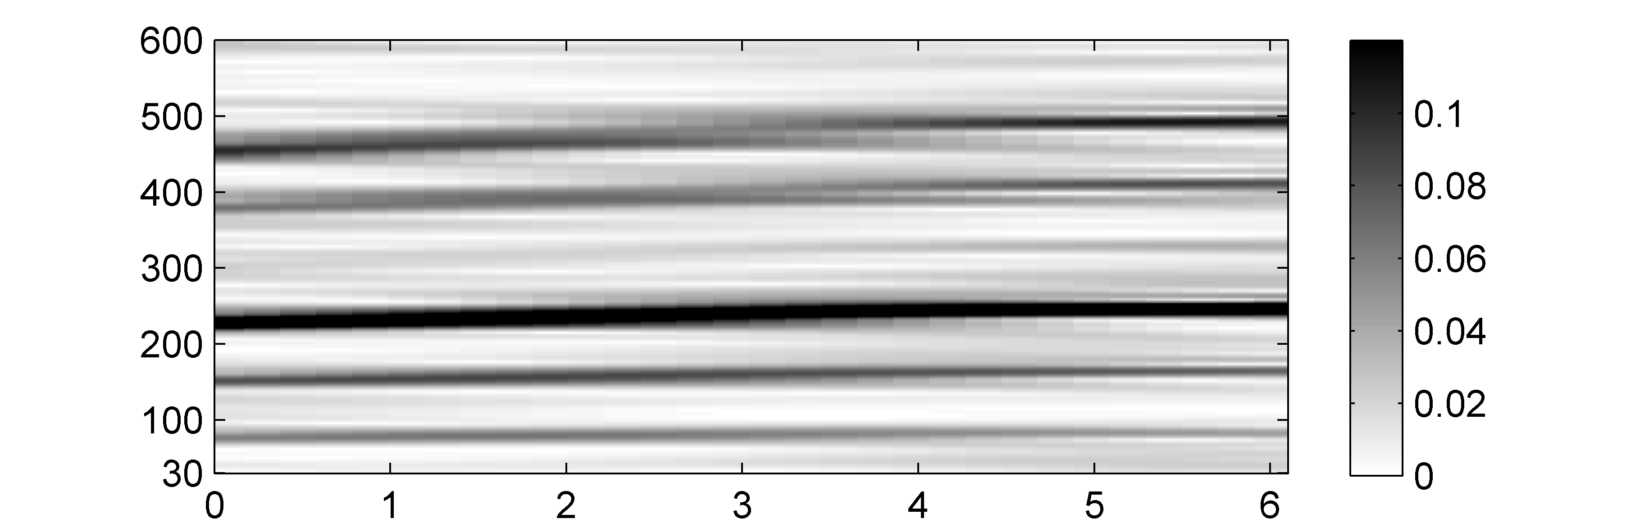
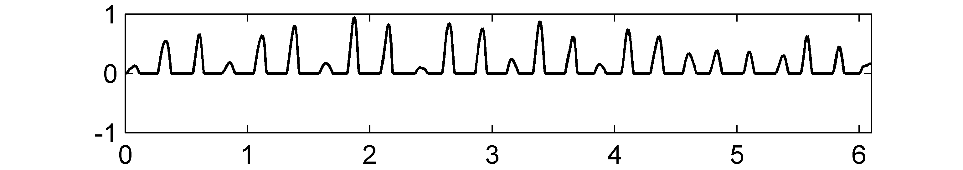
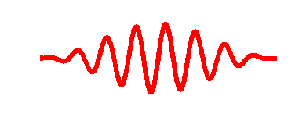
6.2 Tempo Analysis
Fig. 6.13
Tempo (BPM)
Time (seconds)

Slide 28
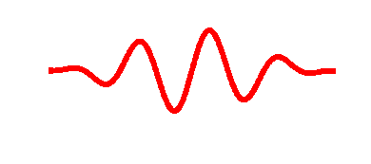
6.2 Tempo Analysis
Fig. 6.13
Tempo (BPM)
Time (seconds)

Slide 29
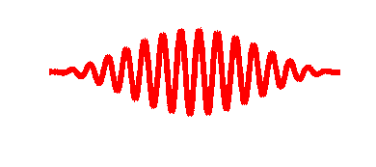
6.2 Tempo Analysis
Fig. 6.13
Tempo (BPM)
Time (seconds)

Slide 30
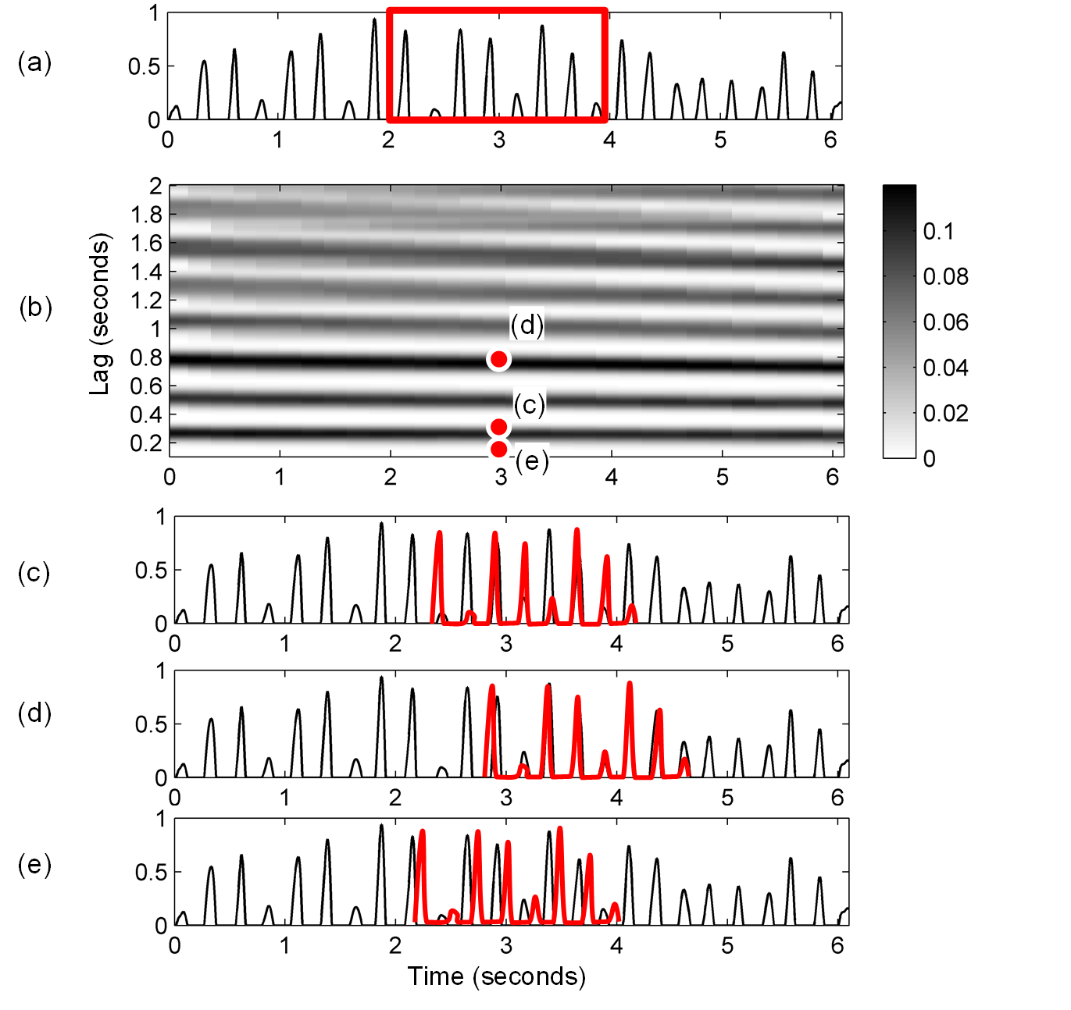
6.2 Tempo Analysis
Fig. 6.13

Slide 31
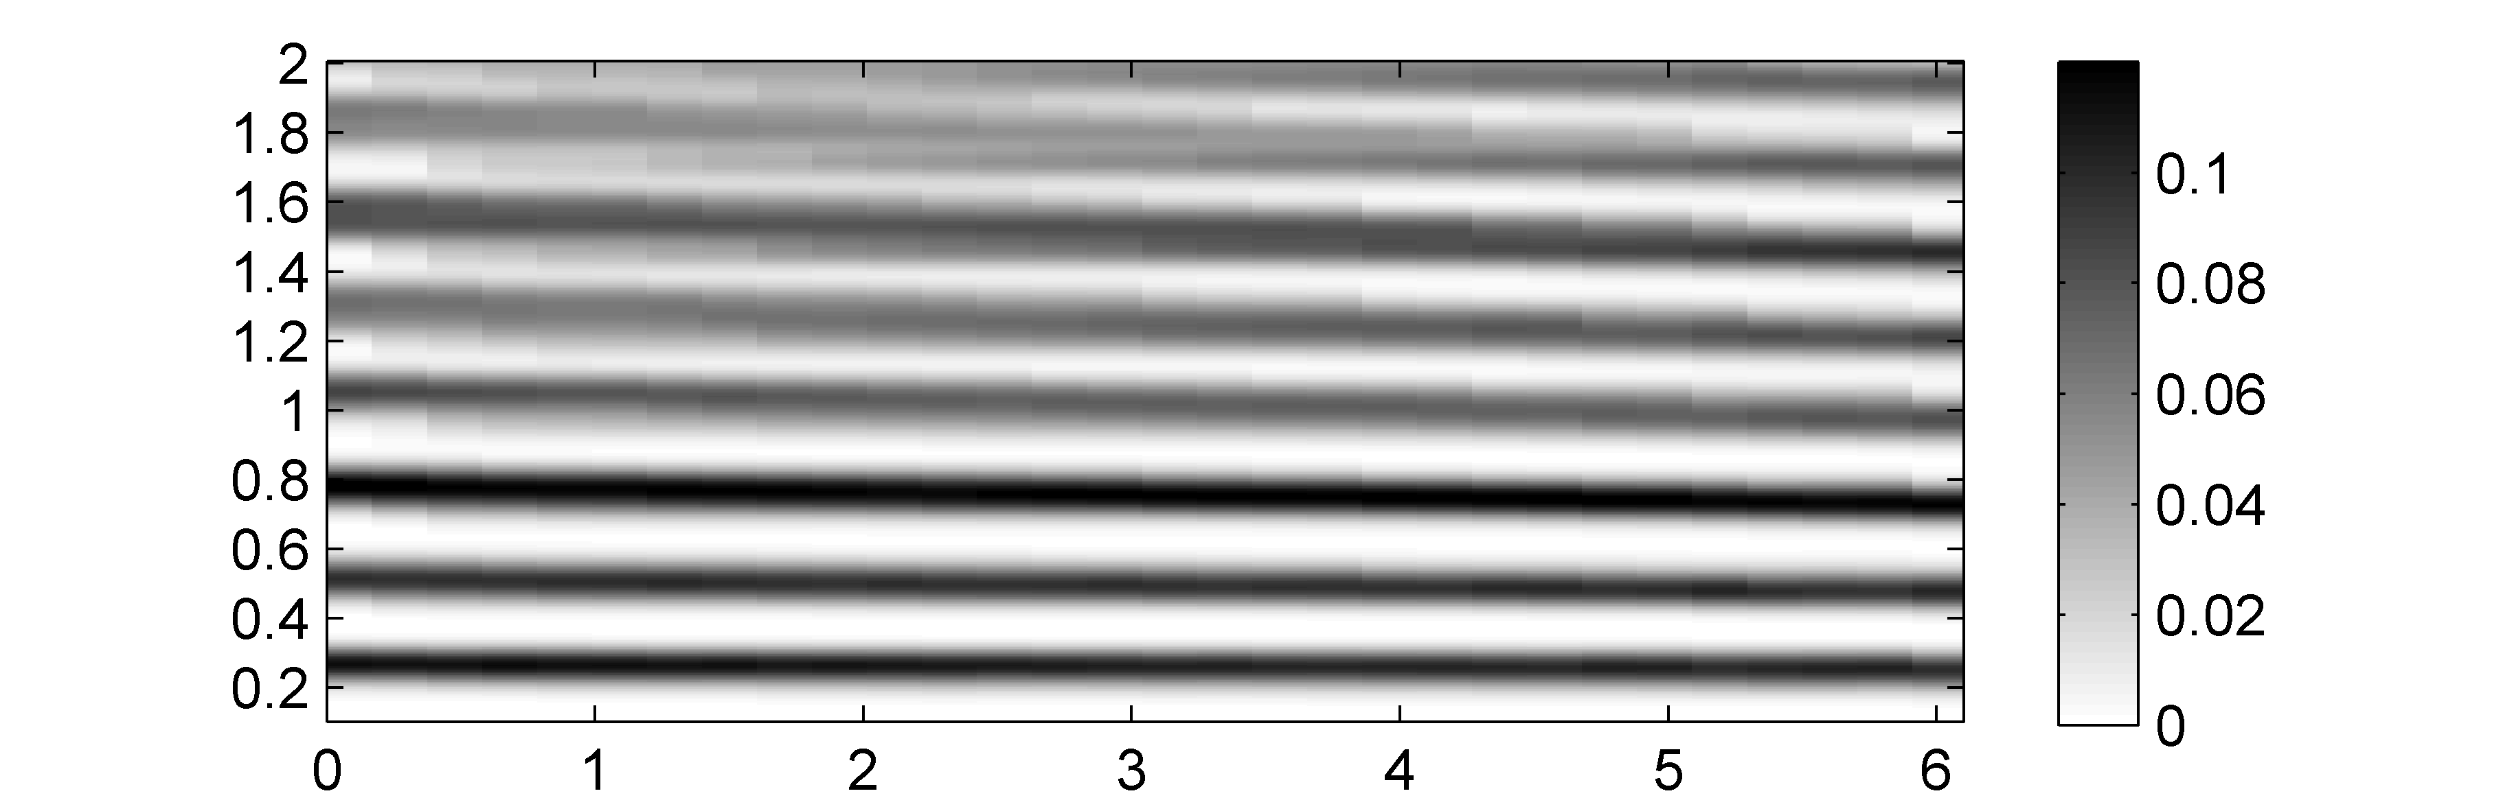
6.2 Tempo Analysis
Fig. 6.14
Lag (seconds)
Time (seconds)

Slide 32
6.2 Tempo Analysis
Fig. 6.14
Lag (seconds)
Time (seconds)

Slide 33
6.2 Tempo Analysis
Fig. 6.14
Lag (seconds)
Time (seconds)

Slide 34
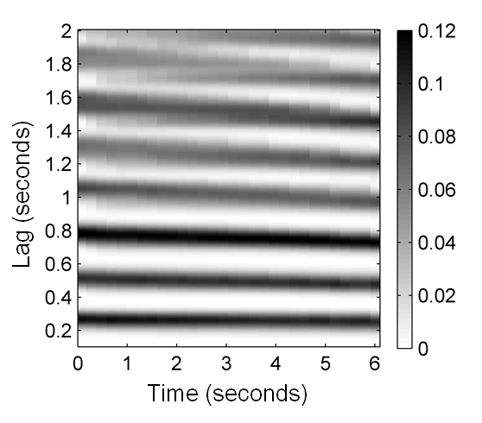
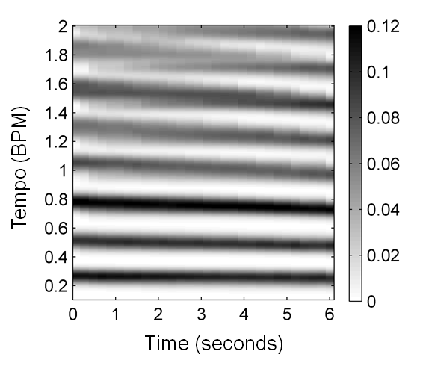
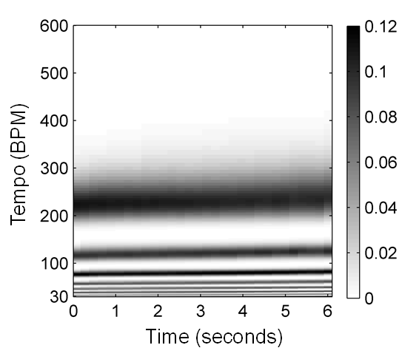
6.2 Tempo Analysis
Fig. 6.15

Slide 35
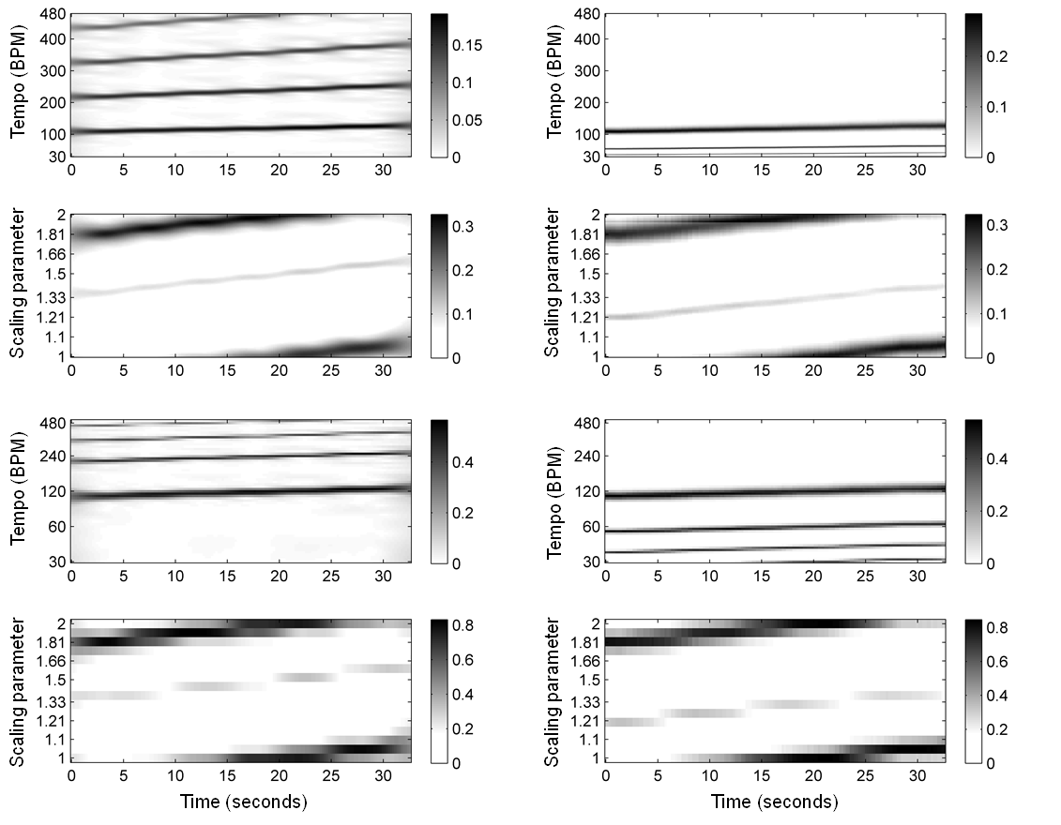
6.2 Tempo Analysis
Fig. 6.16

Slide 36
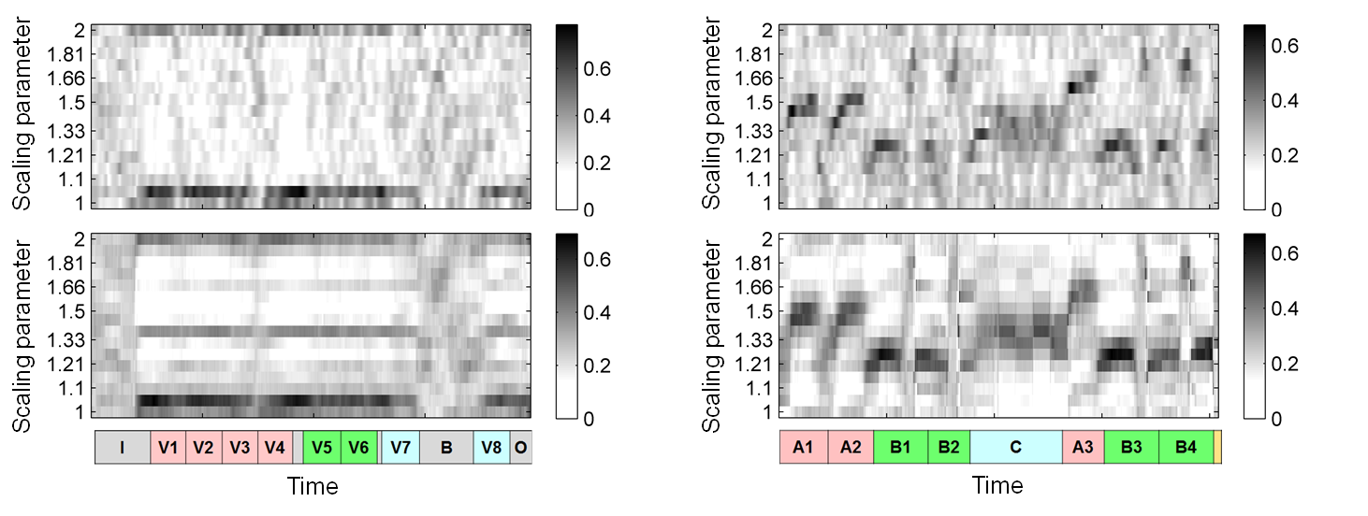
6.2 Tempo Analysis
Fig. 6.17

Slide 37
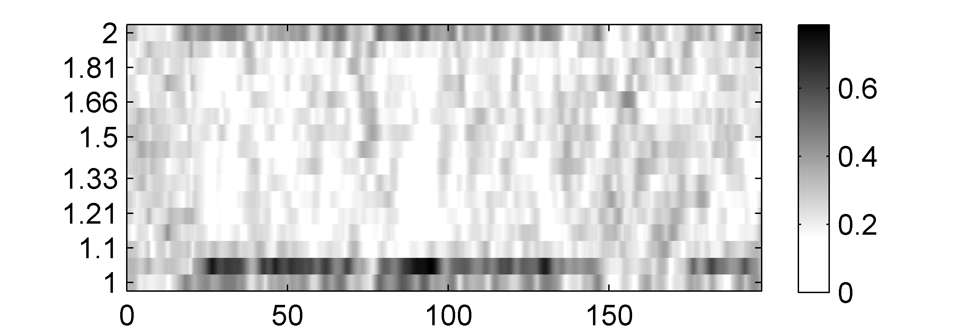
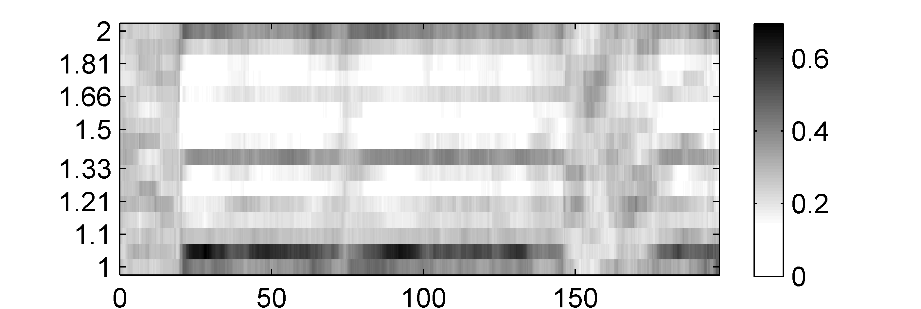
6.2 Tempo Analysis
Fig. 6.17
Scaling parameter
Scaling parameter

Slide 38
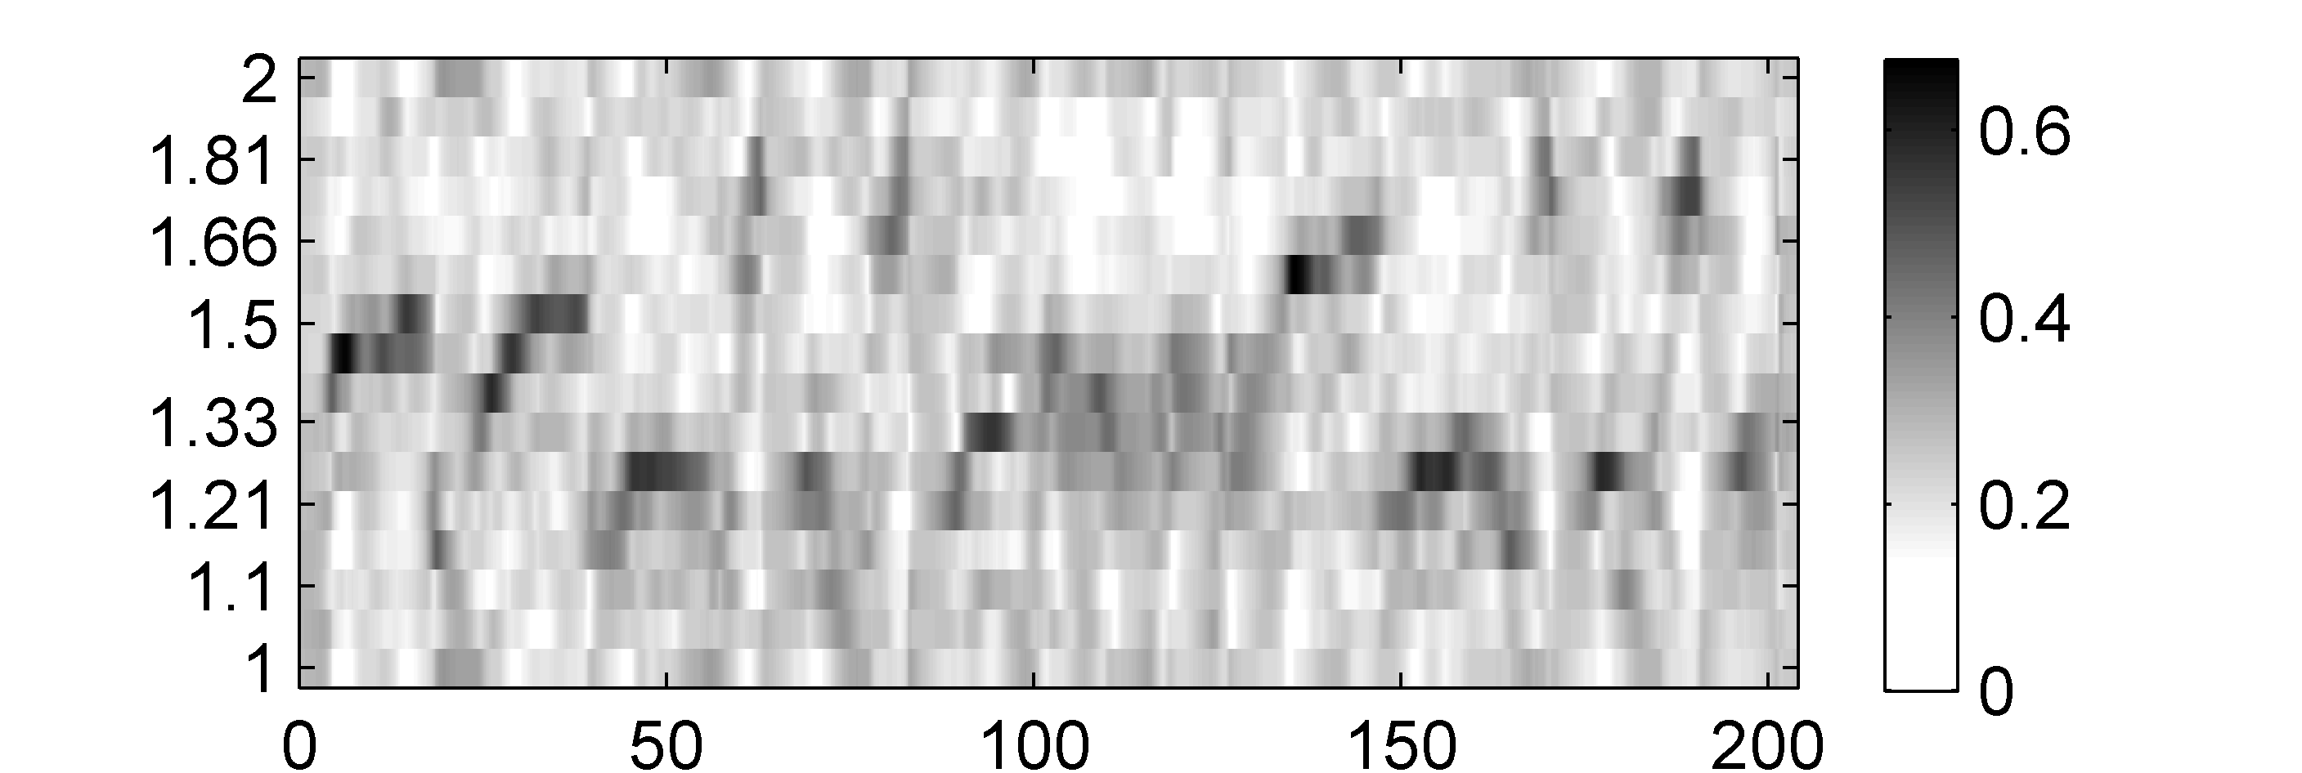
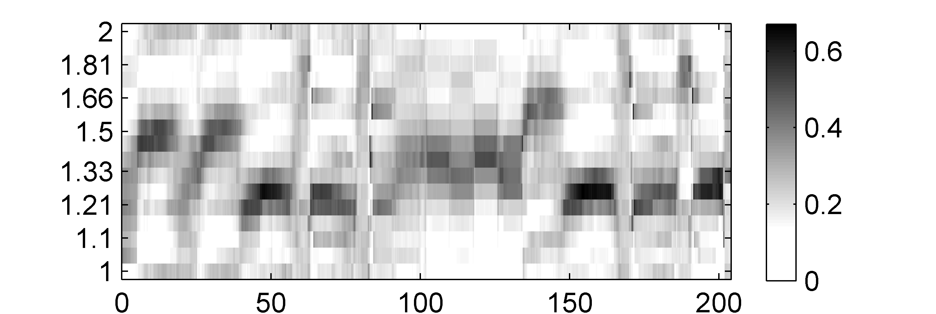
6.2 Tempo Analysis
Fig. 6.17
Scaling parameter
Scaling parameter
Time (seconds)

Slide 39
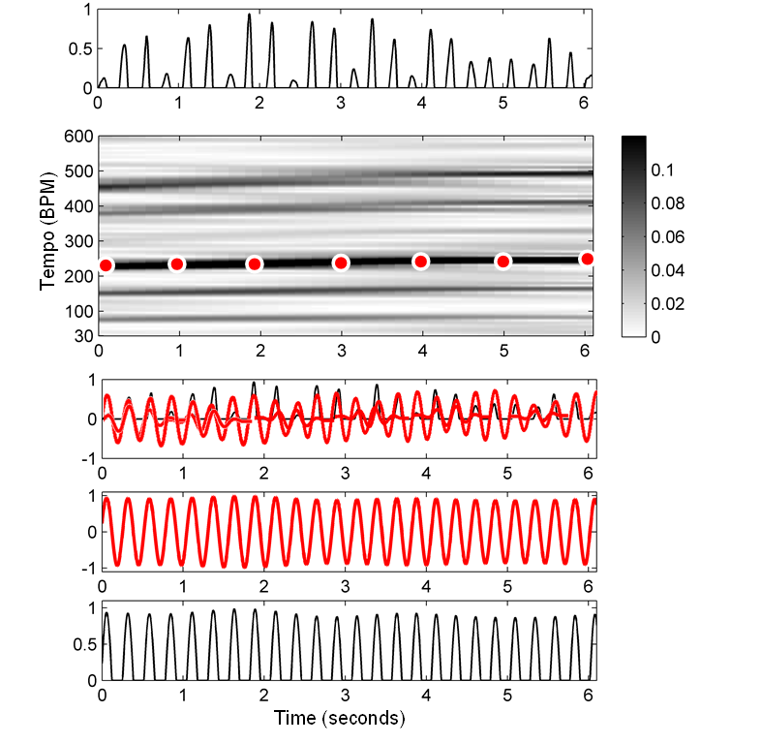
6.3 Beat and Pulse Tracking
Fig. 6.18

Slide 40
6.3 Beat and Pulse Tracking
Fig. 6.18
Tempo (BPM)
Time (seconds)

Slide 41
6.3 Beat and Pulse Tracking
Fig. 6.18
Tempo (BPM)
Time (seconds)

Slide 42
6.3 Beat and Pulse Tracking
Fig. 6.18
Tempo (BPM)
Time (seconds)

Slide 43

6.3 Beat and Pulse Tracking
Fig. 6.18
Tempo (BPM)
Time (seconds)

Slide 44

6.3 Beat and Pulse Tracking
Fig. 6.18
Tempo (BPM)
Time (seconds)

Slide 45

6.3 Beat and Pulse Tracking
Fig. 6.19

Slide 46

6.3 Beat and Pulse Tracking
Fig. 6.20

Slide 47


6.3 Beat and Pulse Tracking
Fig. 6.20
Tempo (BPM)
Time (seconds)

Slide 48


6.3 Beat and Pulse Tracking
Fig. 6.20
Tempo (BPM)
Time (seconds)

Slide 49


6.3 Beat and Pulse Tracking
Fig. 6.20
Tempo (BPM)
Time (seconds)

Slide 50


6.3 Beat and Pulse Tracking
Fig. 6.20
Tempo (BPM)
Time (seconds)

Slide 51

6.3 Beat and Pulse Tracking
Fig. 6.21

Slide 52

6.3 Beat and Pulse Tracking
Fig. 6.22

Slide 53

6.3 Beat and Pulse Tracking
Table 6.1

Slide 54

6.3 Beat and Pulse Tracking
Fig. 6.23

Slide 55



6.3 Beat and Pulse Tracking
Fig. 6.23
Time (seconds)

Slide 56


6.3 Beat and Pulse Tracking
Fig. 6.23
Time (seconds)

Slide 57

6.4 Further Notes
Fig. 6.24

Slide 58

6.4 Further Notes
Fig. 6.24
Frequency (pitch)
Time (seconds)

Slide 59

6.4 Further Notes
Fig. 6.24
Frequency (pitch)
Time (seconds)

Slide 60

6.4 Further Notes
Fig. 6.24
Frequency (pitch)
Time (seconds)

Slide 61

6.4 Further Notes
Table 6.2

Slide 62

6.4 Further Notes
Table 6.3

